Slide 1

Meeting Etiquette
Please be on Mute all the time.
Turn off Video, So that we can save bandwidth.
There is separate Q&A Section in End Please use that, Add questions in Google Form.
Break at 12PM for 5 min.
Mute your microphone
To help keep background noise to a minimum, make sure you mute your microphone when you are not speaking.
Be mindful of background noise
Avoid multitasking
All links and Slides will be shared.

Slide 2
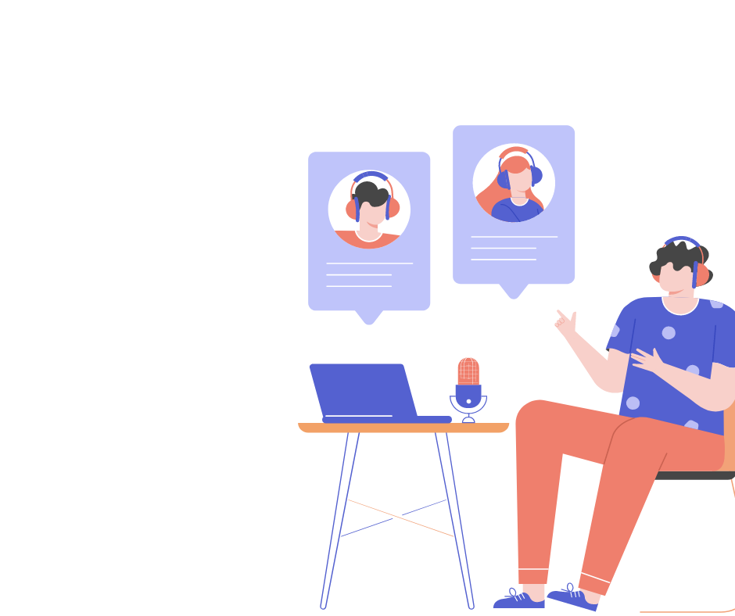
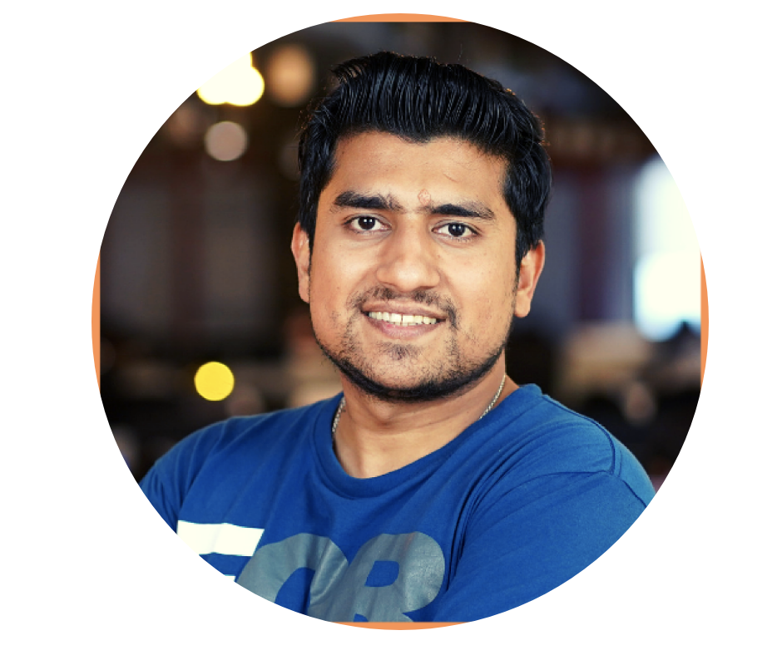
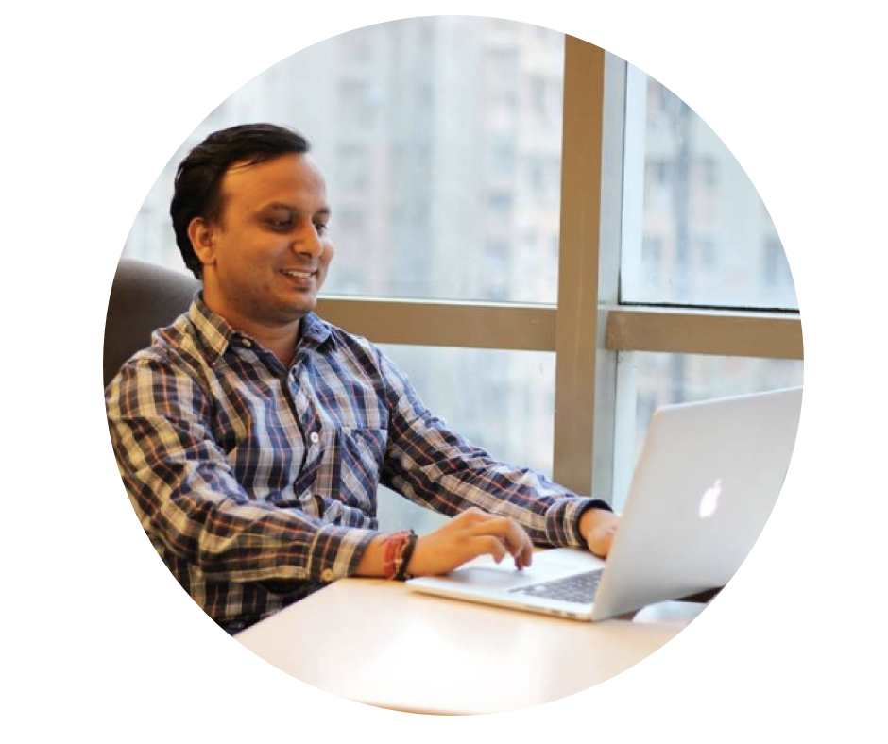
{ SDET } BluePrint.
Pramod Dutta
Chandan
Cypress E2E Testing

Slide 3
Agenda
Introduction to Cypress
Why Cypress & Cypress Popularity
Cypress Components & Cypress Architecture
Perform LIVE Project #1
QnA
UnLock Cypress Advance Course.

Slide 4
Cypress Introduction.

Slide 5

Why Cypress?
1. Fast execution, Dom Snapshot, Easy Debugging.
2. Automatic Waits for the commands.
3. Problem with the async calls.
4. Mocking the Server response.
5. DOM Snapshot.
6. Force Click and Smart assertions.
7. You can avoid flaky test, create robots and reliable test.
8. Video, Screenshot and Inbuilt Reporting.
9. Cross Platform Testing. ( CBT)

Slide 6
Why Cypress?
1. Fast execution, Dom Snapshot, Easy Debugging.
2. Automatic Waits for the commands.
3. Problem with the async calls.
4. Mocking the Server response.
5. DOM Snapshot.
6. Force Click and Smart assertions.
7. You can avoid flaky test, create robots and reliable test.
8. Video, Screenshot and Inbuilt Reporting.
9. Cross Platform Testing. ( CBT)

Slide 7
Cypress Notes
Notes - https://www.notion.so/digitaldutta/Cypress-End-to-End-Testing-Framework-Cypress-MasterClass-e5cd4df13843491ea5e69e07b822427d

Slide 8
Cypress Test
https://www.notion.so/digitaldutta/Cypress-Introduction-Test-Structure-52447e42424940309308c1448f920d47

Slide 9
Fixture in Cypress

Slide 10
Page Object in Cypress.

